Slide 1
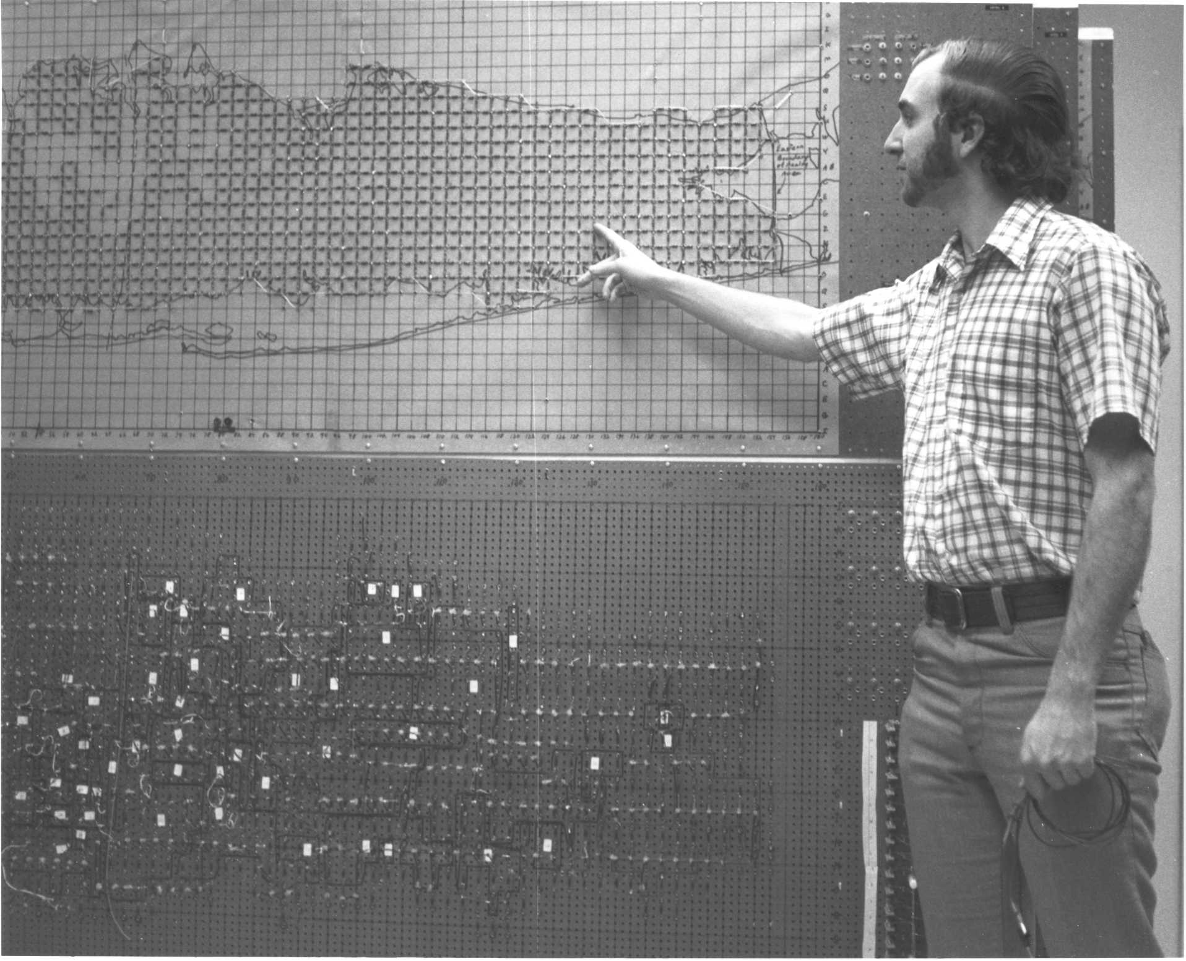
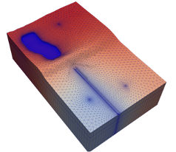
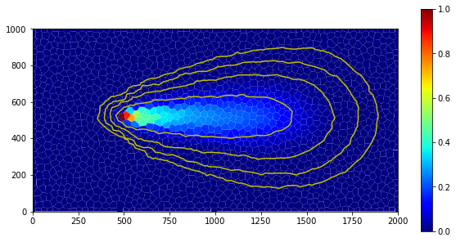
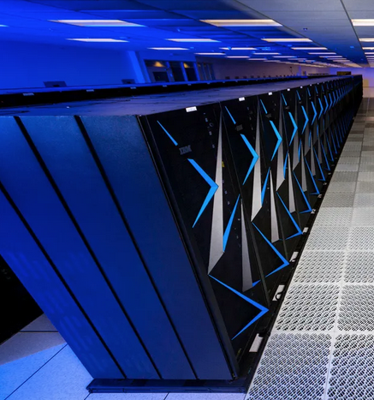


Status and Future Directions
Parallel MODFLOW Training Class, July 13-14, 2023, Lakewood, CO
Notes:
Why parallel?
Different forms of parallelism, which one for MODFLOW 6?
Theoretical expectations on performance?

Slide 2
Status Parallel MODFLOW 6
Capabilities:
Groundwater Flow (GWF) ✓
MVR ✗
BUY ✗
VSC ✗
Groundwater Transport (GWT) ✗
User experience related:
Load balance
User specified 
Feedback from run 
Improve output readability 
More performance gain 
Bring IMS preconditioner to use in parallel simulations (MILU) 
Workflow:
ModelSplitter
GWF ✓
GWT ✓
Splitting HFBs 
Split coupled models 
Other tools:
Merge parallel output data 
Other other tools?

Slide 3
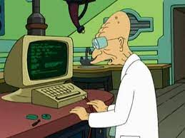
How are planning on using parallel MF6?
Regional models, lots of nodes (e.g. MERAS3)
Long transient models with transport and buoyancy (x3)
Highly refined insets in larger coarser models (MERAS3x, others)
Using parallel MF6 with mover for many applications
SWI once available
PEST + parallel MODFLOW for transient models with very long runtime

Slide 4

What’s bad about parallel MODFLOW?
Documentation
Troubleshooting instructions for parallel
Metric for parallel efficiency: is it worth the effort, how do I know?
All those extra dependencies and the complexity of installation

Slide 5

What’s good about parallel MODFLOW?
Speedup
Models that we couldn’t run, can be run now
ModelSplitter worked nicely, and recombination that is already present is great
With same input files, same MODFLOW knowledge, you can run parallel
(developer’s argument) Separation of concerns: able to work on MODFLOW without knowing the nasty details of parallelization
(Windows support is not crucial for this group, the WSL route works fine)

Slide 6

How can we improve this class?
Mixed feelings about live coding
Sometimes distracts from the main course purpose
Others helpful in learning the techniques, but more time would be better (3rd day?!)
The theory presentation preceded using the new concepts such as SLURM sbatch etc. So when you start using it, you might have forgotten what is all was about…

Slide 7

What should we work on next?
MVR
GWT

Slide 8
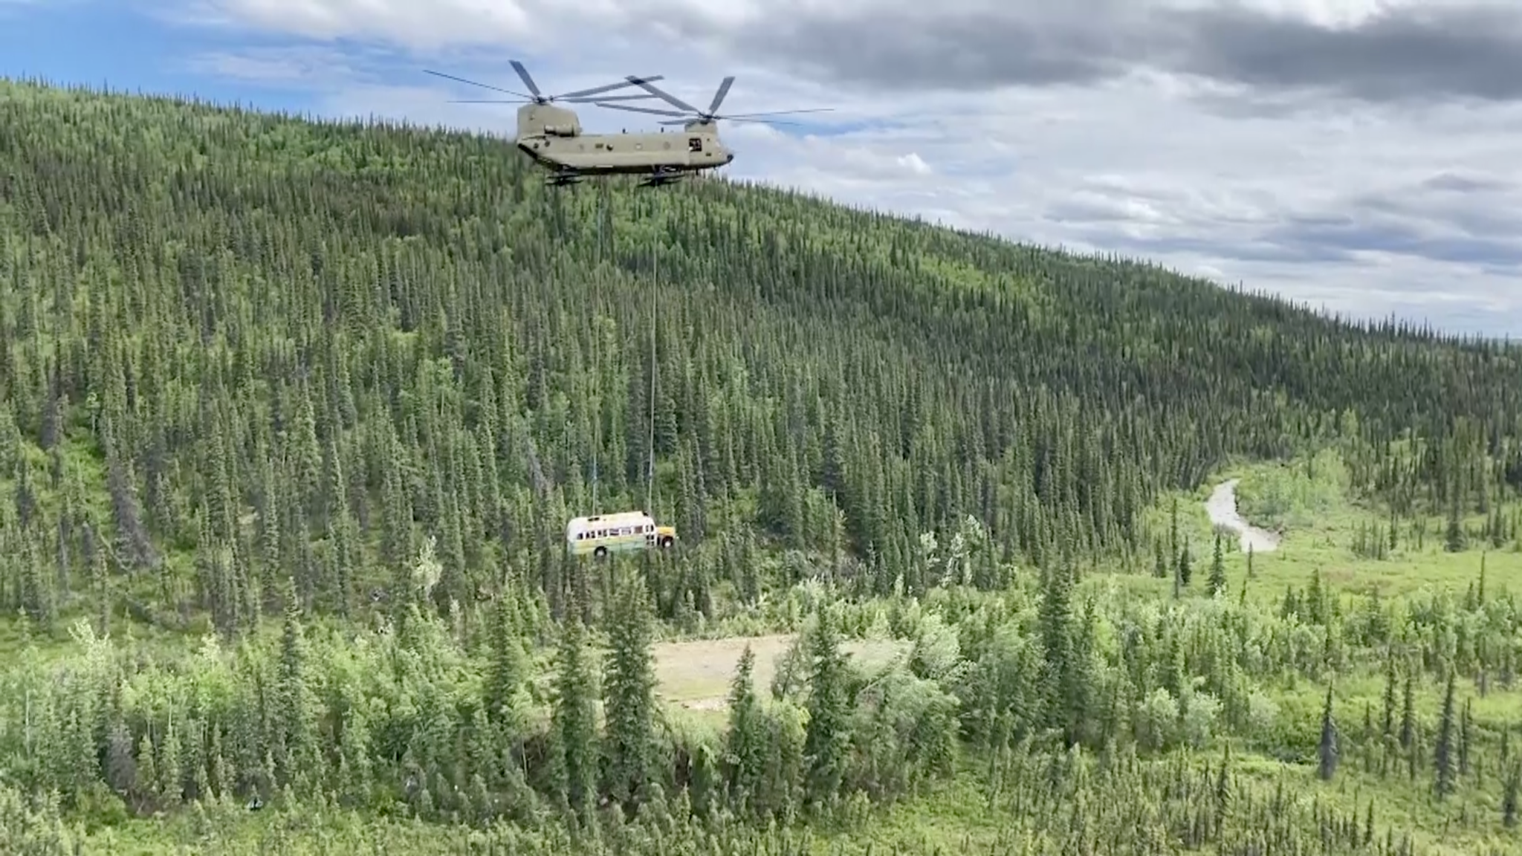
Questions?

